Slide 1
Patience as a pedagogical virtue, and impatience as well?
Joop Berding
www.joopberding.nl
(With an English page)
LinkedIn & Twitter @joopberding

Slide 2
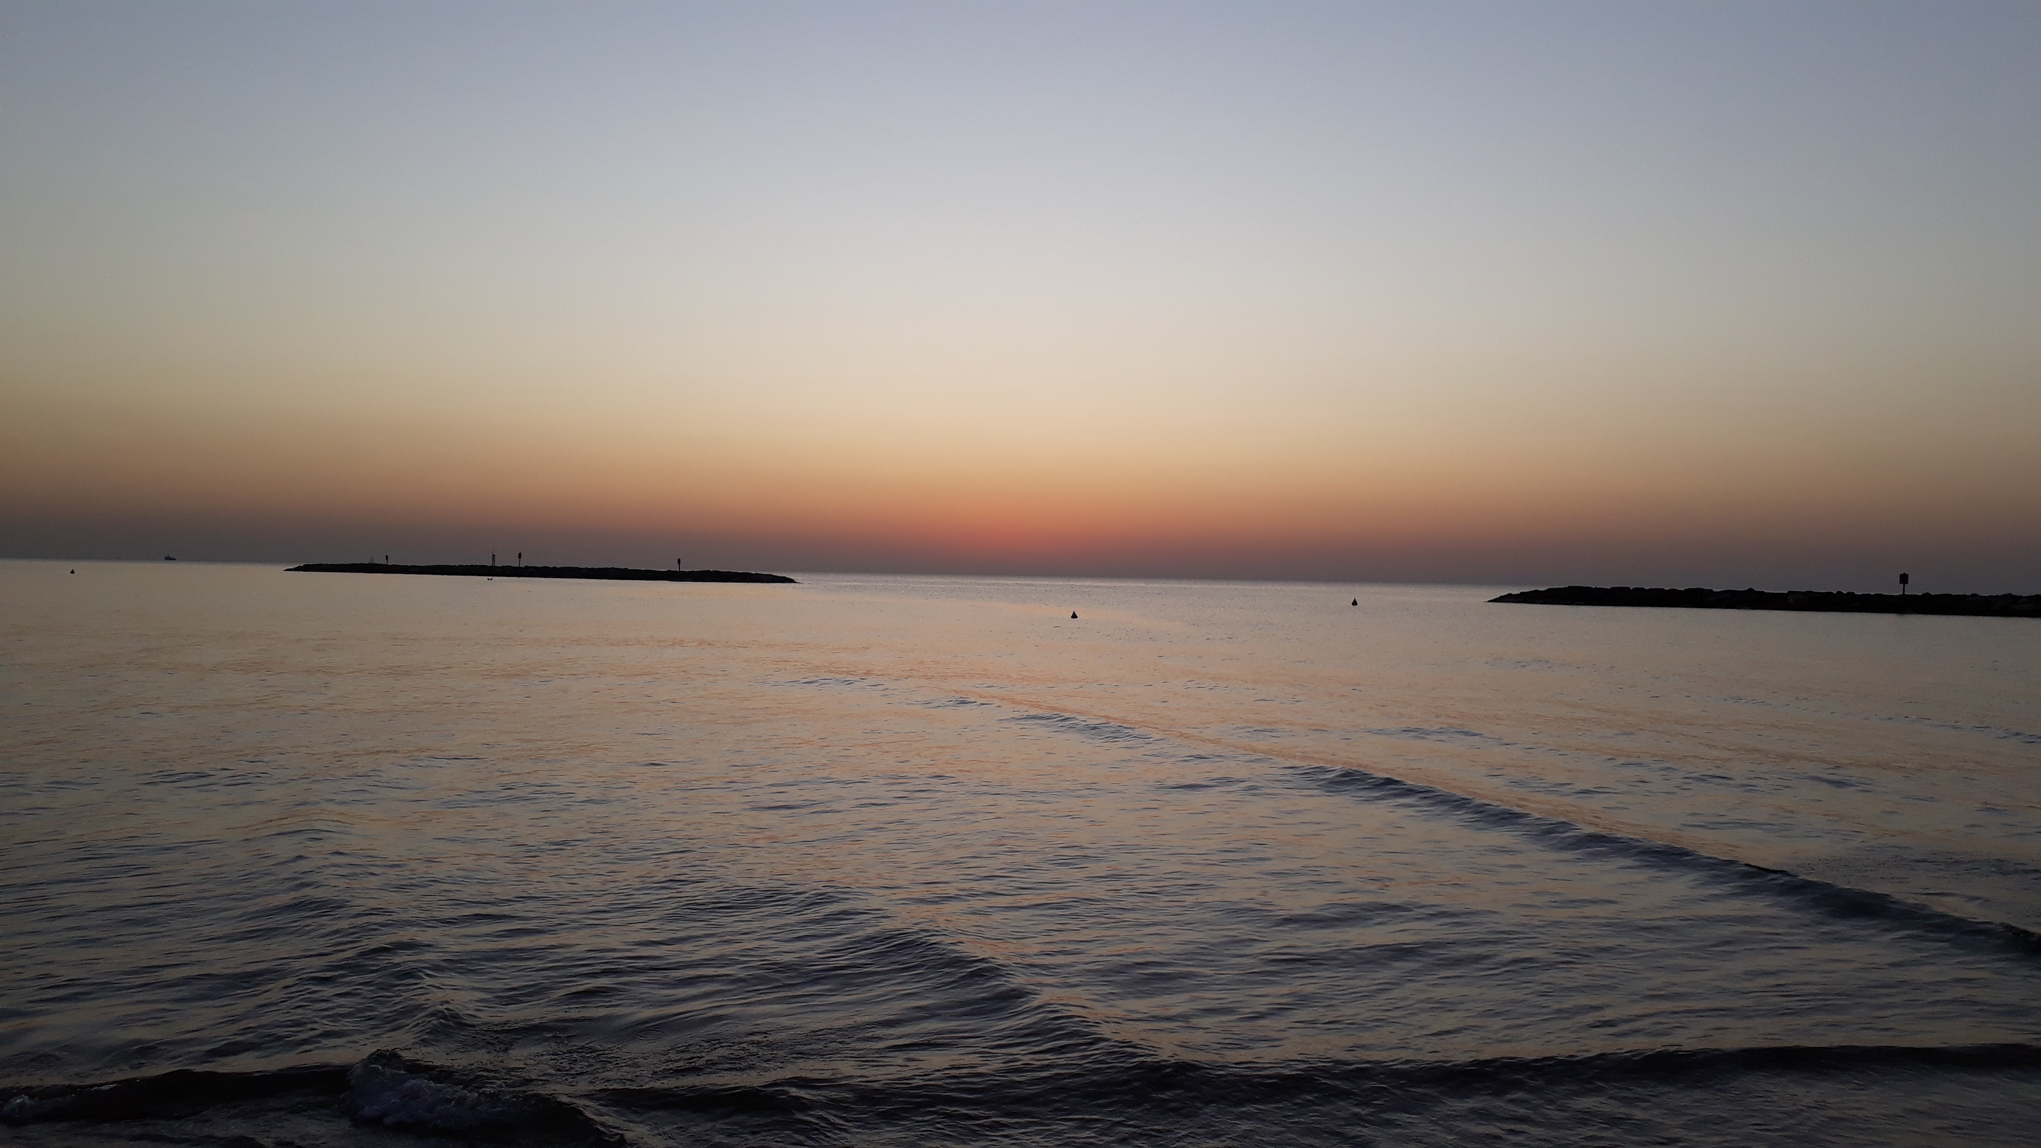
A scene at the beach

Slide 3
A hundred infants
I bend over the bed of each one of them...

Slide 4
Another side of Korczak
Critique of child-unfriendliness
"How can you live under the same roof with the likes of him?"

Slide 5
The practice of patience, or overcoming impatience the children's court: a "republican" way of living together the letterbox -- educating for patience

Slide 6
No saint
No time
No patience

Slide 7
Conclusion:
Although many educators have a lot of patience, impatience is always around the corner. And that is okay. Unless it goes over in to violence.
Even a great educator like Korczak could be very impatient. That is a sobering but also a soothing thought. And it also makes him more human.

